Slide 1
Empowering the SQL Server Professional with Linux Scripting
Kellyn Gorman,
Azure Data Platform Architect
Microsoft

Slide 4


Kellyn Gorman
Azure Data Platform Architect
Kellyn has been with Microsoft for over a year now working in the Analytics and AI team in Higher Education but spends a percentage of her time migrating large Oracle environments over to Azure bare metal.
Blogger, Author, Speaker
Kellyn writes on two of the top 50 database blogs in the world, known for Oracle and Microsoft technical content, has written five books, including one on Diversity and Inclusion. She mentors, sponsors and speaks in both the Oracle and Microsoft communities as part of giving back to the community.
Azure Data Platform Architect, Microsoft
President, Denver SQL Server User Group
@DBAKevlar
https://www.linkedin.com/in/kellyngorman/
Kellyn has been the president for over two years now, continuing to support this incredible user group while on the road in her RV, traveling the US.
Kellyn.Gorman@Microsoft.com
Notes:
[Moderator Part]
This 24 Hours of PASS session is presented by Kellyn Pot'Vin-Gorman. Kellyn is a member of the Oak Table Network and an Idera ACE and Oracle ACE Director alumnus. She is a Data Platform Architect in Power BI with AI in the EdTech group at Microsoft. Kellyn is known for her extensive work with multi-database platforms, DevOps, cloud migrations, virtualization, visualizations, scripting, environment optimization tuning, automation, and architecture design. Kellyn has spoken at numerous technical conferences for Oracle, Big Data, DevOps, testing, and SQL Server. Her blog (http://dbakevlar.com) and social media activity under her handle, DBAKevlar, is well respected for her insight and content.
[move to next slide]

Slide 5
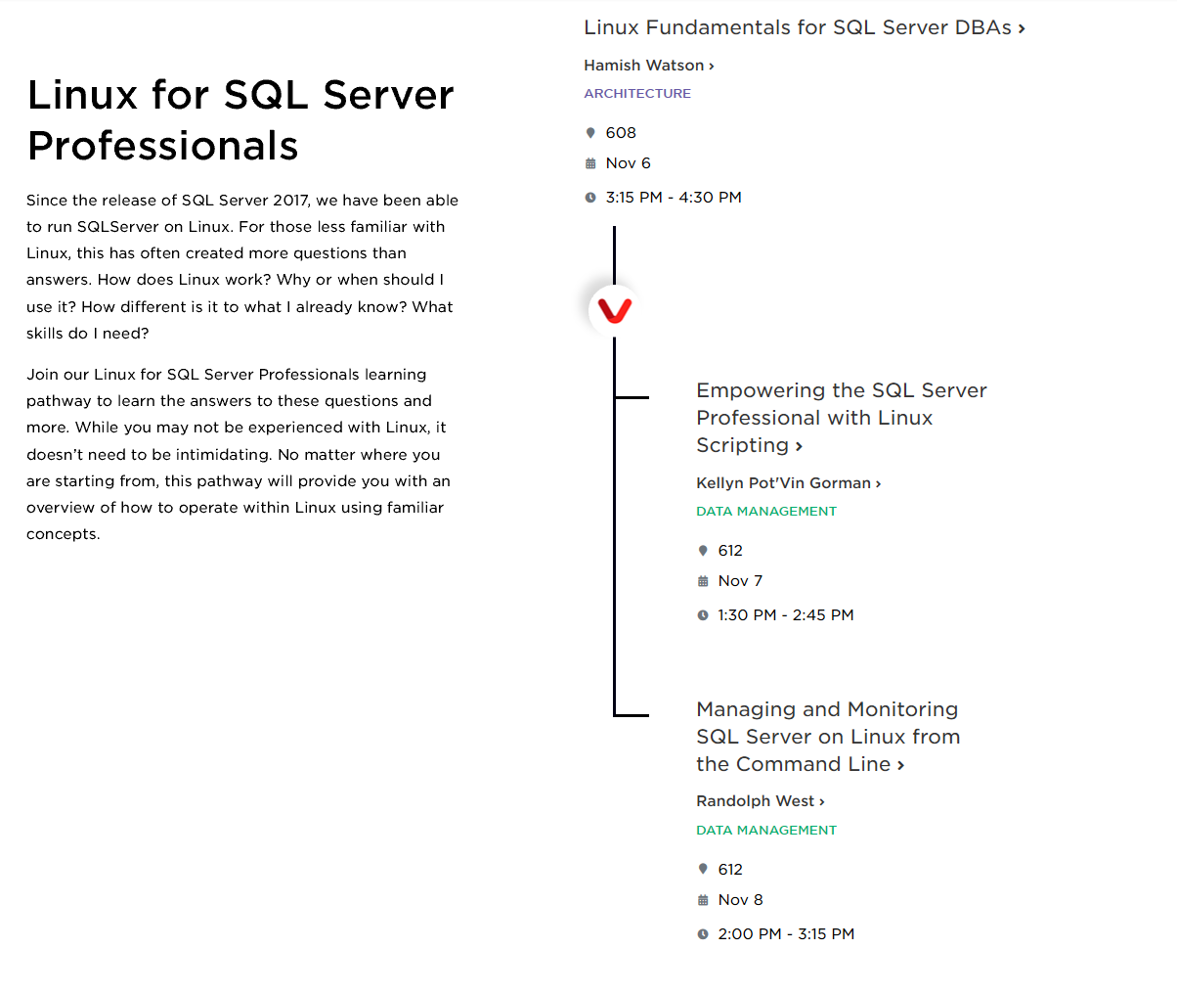
Summit Learning Pathways

Slide 6

What This Session Is….
Teach you the basics around Linux, (aka bash) scripting.
Play along if you want, just need a Linux machine to log into or log onto.
Scripts and slides will be available post the session on https://github.com/Dbakevlar/Summit2019
This includes a VI(M) Cheatsheet!

Slide 7
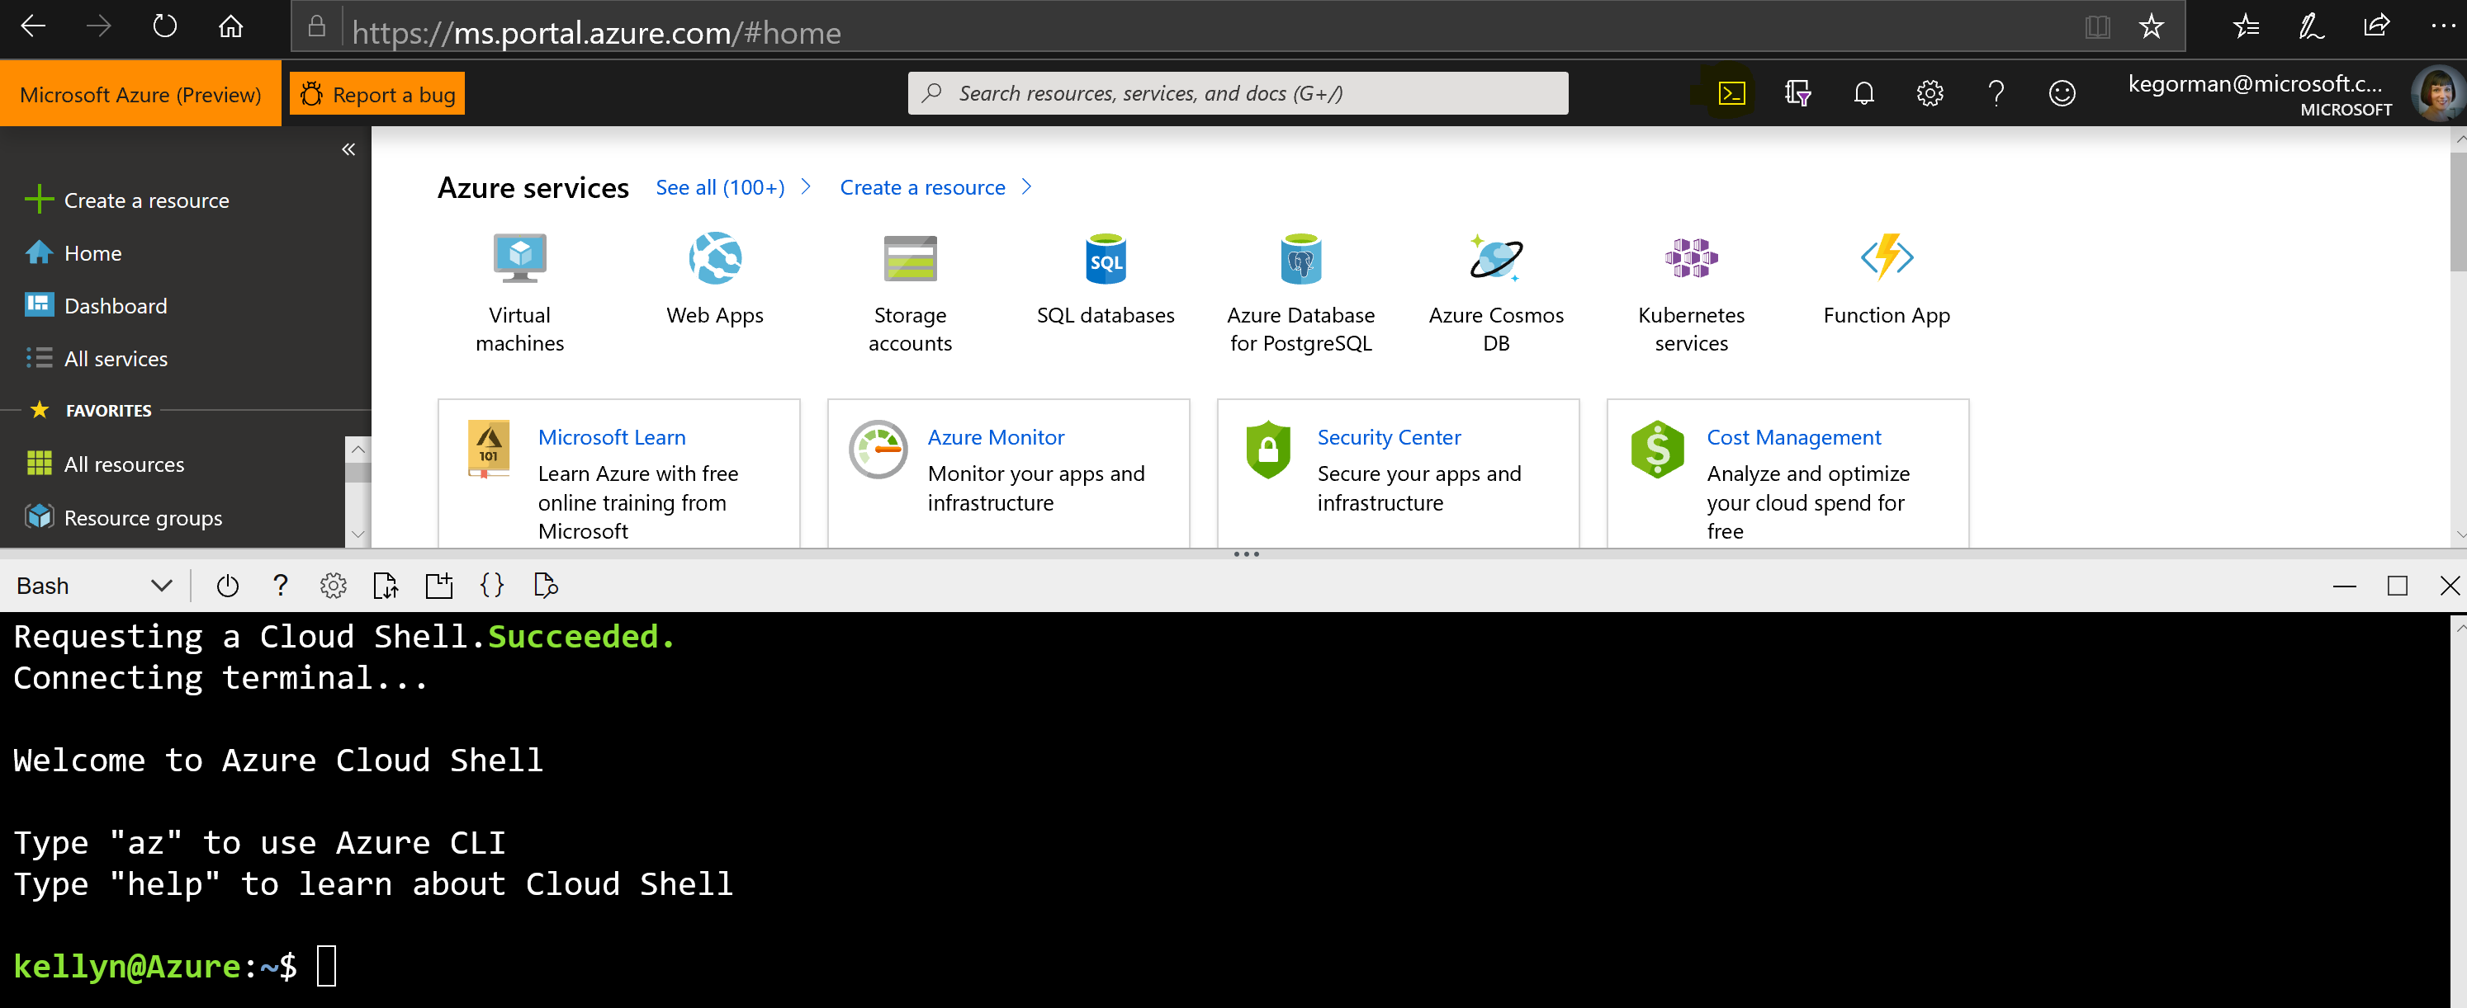
One Way: Azure Cloud Shell
Supports both BASH and PowerShell
Can be used with persistent cloud storage
https://docs.microsoft.com/en-us/azure/cloud-shell/overview

Slide 8
Choose Wisely How You Author Your Scripts
Scripts should be easy to:
Read
Edit
Execute

Slide 9
Even if You Don’t Already Know How to BASH…
The following tips are good to consider in any scripting language when available
Are good practice to be a good coding team member
May save your life some day, (or keep you from getting killed by your team members…☺)

Slide 10

Writing a Script Should be…
Like writing a paper. It should include the following:
An Introduction
A Body
A Conclusion

Slide 11
The Introduction

Slide 12
Set the Shell to Use
For many Linux machines, there may be more than one:
Find out which shell is in use:
which bash
Setting it in your script is done at the very first line of your script:
#!/bin/bash
OR
#!/bin/sh -C Shell
#!/bin/ksh -Korn Shell

Slide 13
What Happens If You Don’t?
Normal Execution with the shell set in the script:
./<script name>/sh <arg1> <arg2>
Without shell set in script:
/bin/bash ./<script name>/sh <arg1> <arg2>
The script must state what shell is to be used with the script EVERY TIME.

Slide 14
Exit When Mistakes are Made
Saves from clean up, easier to recover from.
Added at the top of the script under the designation of shell
set –e
set –o errexit

Slide 15
Also Exit if Undeclared Variables, etc.
Blank answers for variables, (arguments) can leave a script to execute incorrectly or worse.
Require declarations to be set completely or the script exits:
set -o nounset
OR
set –u
set -euo pipefail

Slide 16
Add Debugging to Your Script
Want to know what went wrong?
#!/bin/bash
set -vnx
Arguments, (any or all) to be used:
Argument | What it Does
-v | Verbose mode- shows all lines as they are parsed by the execution.
-n | For syntax checking. The script doesn’t actually execute.
-x | Shell tracing mode- will step through each step and report any errors

Slide 17
Set up Alias’ and Environment Variables
Update the .bashrc with global alias’ and environment variables that support anything that is used by the login regularly.
Create .profile with a unique extension, (.profile_sql19, .profile_net) to support unique applications.
This cuts down on significant variable setting and coding, requiring only one location to update/manage.

Slide 18
Write a Header for your Script
The # sign can help create a header and signal BASH that it’s for informational purposes only:
####################################################
# Title: summit_demo.sh #
# Purpose: Summit Demo script for Linux #
# Author: Kellyn Gorman # # Notes: Script will need three arguments. #
####################################################

Slide 19
Four Choices in Passing Environment Variables
Declaration hard-coded in script
Passed as part of execution command for script
Interactively read as part of script execution
Dynamically generated from other values in script

Slide 20
Choose Wisely
Variable Type | Pro | Con
Hard-coded | No typos | Static, no interaction
Passed during execution | More interactive and code is more dynamic, great for automation | Can suffer typos, no hints of values required
Interactively read as part of execution | Very interactive and can be prompted with hints/options | Requires interaction and not made for scheduling or automation
Dynamically generated from other values | Dynamically happens, requires no/little input from users. Excellent for automation | Little/no control over values, dependent on values passed or existing from sources.

Slide 21
Start of our Script
summit_demo_int.sh
#!/bin/bash
#############################################
# Script Name: summit_demo_int.sh #
# Author: Kellyn Gorman #
# Usage: For Linux Scripting Demo #
# Notes: Hard coded values to begin #
#############################################
export dir_name = summitdir
export file_name = summit.lst
export log_name = summit.log

Slide 22
How to use Variables Once Declared in a Script
dir_name becomes $dir_name
file_name becomes $file_name
…and so on…
Any variables in the .bashrc or .profile can be used in scripts and if reused often, should be considered set in these files.

Slide 23
Move from Hard Coding to Passing Variables at the Execution
Changed at the Introduction of the script
Makes script more robust and flexible
Makes script reusable
Can be done multiple ways
Set at session/logon
Set as part of script execution

Slide 24
Start of our Script
summit_demo_arg.sh
#!/bin/bash
#############################################
#############################################
export dir_name = <generic dir path>
export file_name = <static file name>
export log_name = <static log name>
Export the summitdir variable and run the summit_demo_arg.sh:
export dir_name=summitdir
./summit_demo_arg.sh

Slide 25
Update the Script to Interactive Values
Export the environment variables as part of a profile or part of your .bashrc OR add to the script/session. This is one more way to make the script easier to use.
export dir_name = <dir path>
export file_name = <generic_file_name>
export log_name = <generic_log_name>
To execute, we would change to execution path ./<script name> $1

Slide 26
Start of our Script
summit_demo_val.sh
#!/bin/bash
export acro=$1
#############################################
#############################################
# Directory is already set, just need to set the file/log name
# Note, the files are unique to the script, but generic to the environment session:
export dir_name=${dir_name}/${acro}<dir_name>
export log_name = ${dir_name}/${acro}<log_name>

Slide 27
Pass Dynamic Values into our Script, Step 1
usage() { echo "Usage: $0 -f <filename> -l <logname>" 1>&2; exit 1; }
declare file_name=""
declare log_name=""
Notes:
Lets the usage be set, there must be two arguments to pass in the declaration or exit.

Slide 28
Pass Dynamic Values into our Script, Step 2
# Initialize parameters specified from command line
while getopts ":f:l:" arg; do
case "${arg}" in
f)
filename=${OPTARG}
;;
l)
logname=${OPTARG}
;;
esac
Done
shift $((OPTIND-1))
Notes:
Let the script know that values will be passed in for the arguments in the following section.

Slide 29
Pass Dynamic Values into our Script, Step 3
if [[ -z "$filename" ]]; then
echo “Type in the name of your file:"
read filename
[[ "${filename:?}" ]]
fi
if [[ -z "$logname" ]]; then
echo “Type in your logname:”
read logname
[[ "${logname:?}" ]]
fi
Notes:
Asking our questions of the person executing the script

Slide 30
Script has changed on how we setup our introduction, but body stays the same…. Save your file, (“Esc, :q!” in VIM/VI, which is listed in your VI(M) cheat sheet)
summit_demo_dyn.sh

Slide 31
Test your Environment Variables
Use the scripts you’ve created
Make sure they are executable:
chmod 744 *.sh
Run each of the scripts
Test the variables, are they set?
echo $<variable name>
Do this for each script for each variable…

Slide 32

The Body

Slide 33
The Body of the Script
This is where the code will perform the work as part of the main purpose of the script.
As when writing a paper, this will be the largest section of your script.
Start simple
Add debugging and error exit options as you build out your body.
*Consider building a script as functions- easier to manage and test.

Slide 34
Don’t Leave Others in the Dark
Comments in your scripts
Write in ideas for enhancements
Help explain the logic
Use the # sign to signal your script that it’s a comment.
# This step builds out the database logical objects.
# If the variables aren’t entered, the script will exit.

Slide 35
Goal of Script
Create a directory, (mkdir)
Create an empty file, (touch)
Confirm the creation of the directory with a list, (ls) and write to a log file, ( >)
Confirm the creation of the file with a list, (ls) and append to a log file, (>>)

Slide 36
Create the Body, (Post the Variables)
export dir_name = summitdir
export file_name = ${summitdir}/summit.lst
export log_name = ${dir_name}/summit.log
# Create new directory
mkdir ./${summitdir}
# Create empty file
touch ./${file_name}
# Verify that directory and file exist
ls ./${summitdir} > $log_name
ls ./${file_name} >> $log_name

Slide 37
Don’t Make Users Guess
If there is a step that requires interaction between your script and the user, make it clear what is required to promote success:
This can be done using the ECHO command and placing the statement inside quotes.
echo “Please enter the name of the user:”

Slide 38
Don’t throw away your other scripts
Just as with .Net, Java, Perl, etc., you can run PowerShell scripts from BASH:
pwsh <script name>
You worked hard on scripts or an existing example already exists. Don’t recreate the wheel and consider reusing them, calling them from your BASH script.

Slide 39
Build Out Functions
Functions allow you to group commands and execute them as part of a function name.
Write in any order, execute in the order you want
Place execution at the end of the script to make it easy for managing, testing and understanding steps in a script

Slide 40
Example of Function
# Function Bodies:
function quit {
exit
}
function hello {
echo Hello!
}
# Execute Function:
hello
quit

Slide 41
Our Functions
# First function touch files
function touch_func {
touch ${file}
touch ${log_file}
}
# Second function to Verify that directory and file exist
function write_log_func {
pwd ${home}/${dir_name} > $log_file
ls -ltr ${file} >> $log_file
ls -ltr ${log_file} >> $log_file
}

Slide 42
Function for Last Step- Commented Out!
function clean_func {
rm -rf $dir_name/*
rmdir $dir_name
}
Be careful with rm –rf!!

Slide 43
The Conclusion

Slide 44
If Using Functions
Execute Functions and then-
Add any last logging steps
Clean up any files
Email log files or notifications

Slide 45
Complete our Script
# Conclusion
# Execute Functions and clean up
touch_func
write_log_func
#clean_func # ←function is commented out to begin!
echo “Script has completed” >> $log_name

Slide 46
Always do Clean Up and Notify Completion
Remove any files that were created for script.
Parse log files for success or errors.
Report on success or errors.
Notify the script has finished, successfully or even if it hasn’t.

Slide 47
Executing Functions
Functions are executed as part of the conclusion and…
Makes it easier to test and work with sections of scripts.
Check out the full script: summit_demo_func.sh
Run Script with CLEAN function commented out!

Slide 48
Test out the Scripts!
Note the differences
Note how more commands would be built in.
Notice logging and how commands can be used as well as checks.
More advance utilities/commands: AWK, GREP, SED to do advanced filtering and searching.
Use email utilities like sendmail for notifications, alerting

Slide 49
Summary
Learn Vi/Vim, Nano or another editor to make it easy to write scripts in the Linux terminal.
Use best practices from the beginning so as scripts mature, already easy for others to read, manage and use.
Use dynamic values to make code reusable
Use functions to make easier to manage and test scripts
Use exit codes for variables and errors to keep scripts from running without the right information.

Slide 50
If You Want to Learn More:
Blog Posts, Writing Shell Scripts, Parts 1-4
PASS Summit Session, Empowering the SQL Server Professional with Linux Scripting- Thursday, Nov. 7th, 1:30pm, RM 611-614
Web Tutorials, Linux Shell Scripting
Edx Class, Linux Command Line Basics
Linux Scripting Class, Linux Tutorials

Slide 52
Speaker name
@DBAkevlar
dbakevlar@gmail.com

